Slide 1
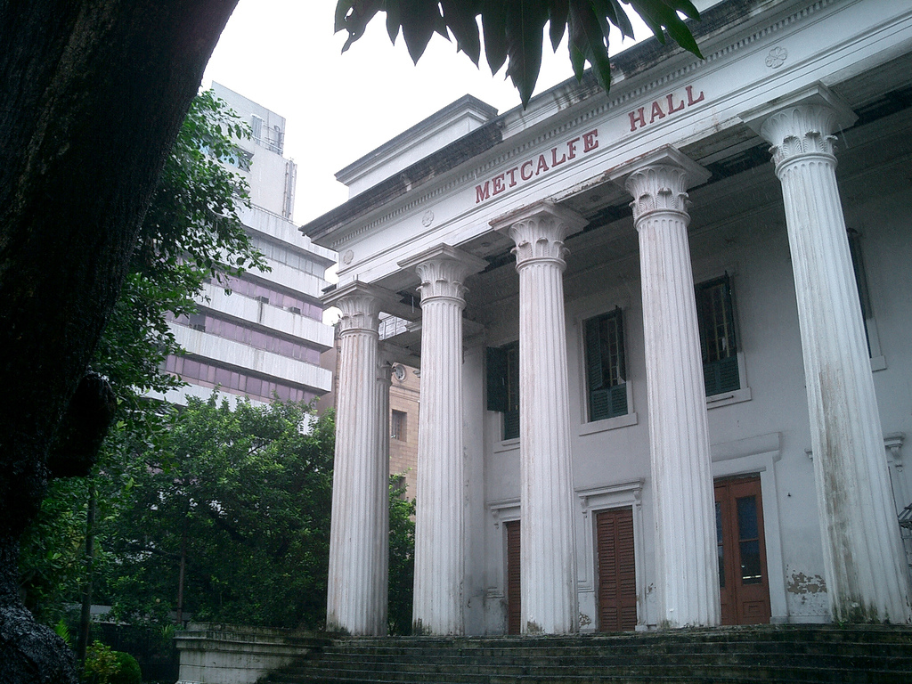
Metacalfe Hall Calcutta
Notes:
SOURCE – FLICKR CC - http://www.flickr.com/photos/matbooth/364288183/sizes/l/

Slide 2
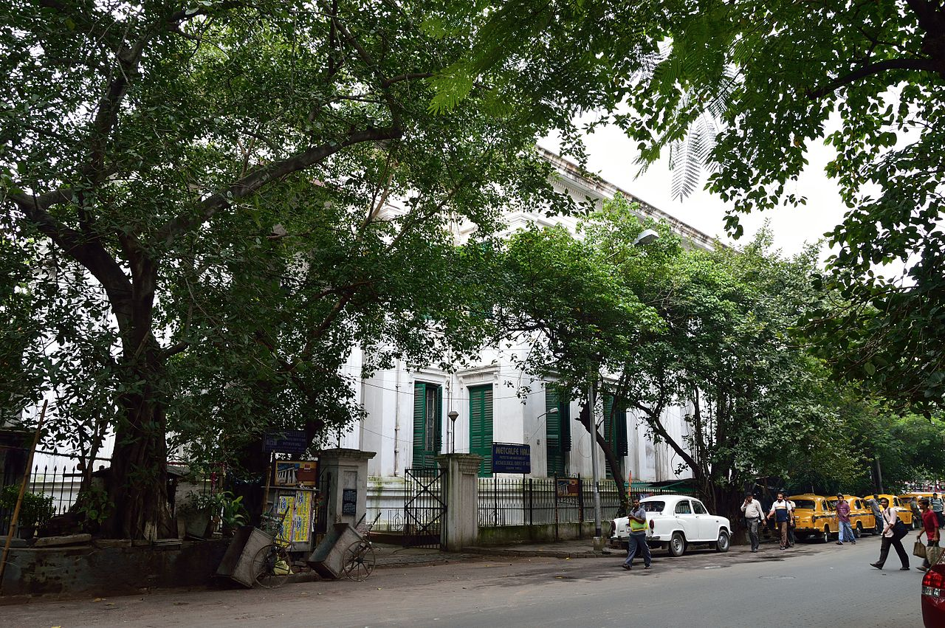
Notes:
WICI CC- http://commons.wikimedia.org/wiki/File:Metcalfe_Hall_-_Kolkata_2012-09-22_0311.JPG

Slide 3
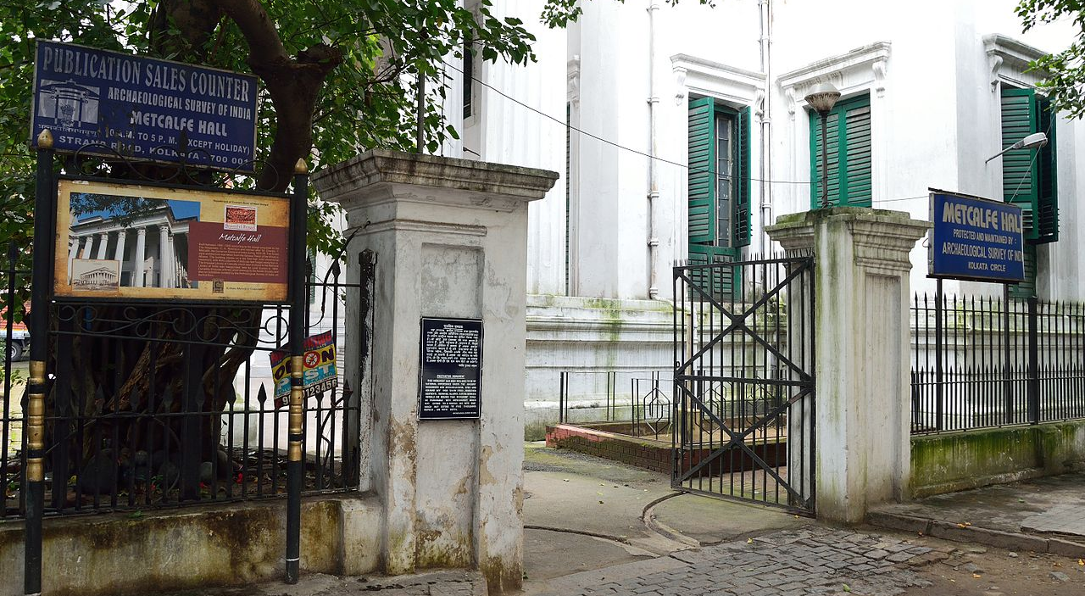
Notes:
WIKI CC - http://commons.wikimedia.org/wiki/File:Metcalfe_Hall_Entrance_-_Hare_Street_-_Kolkata_2012-09-22_0321.JPG

Slide 4
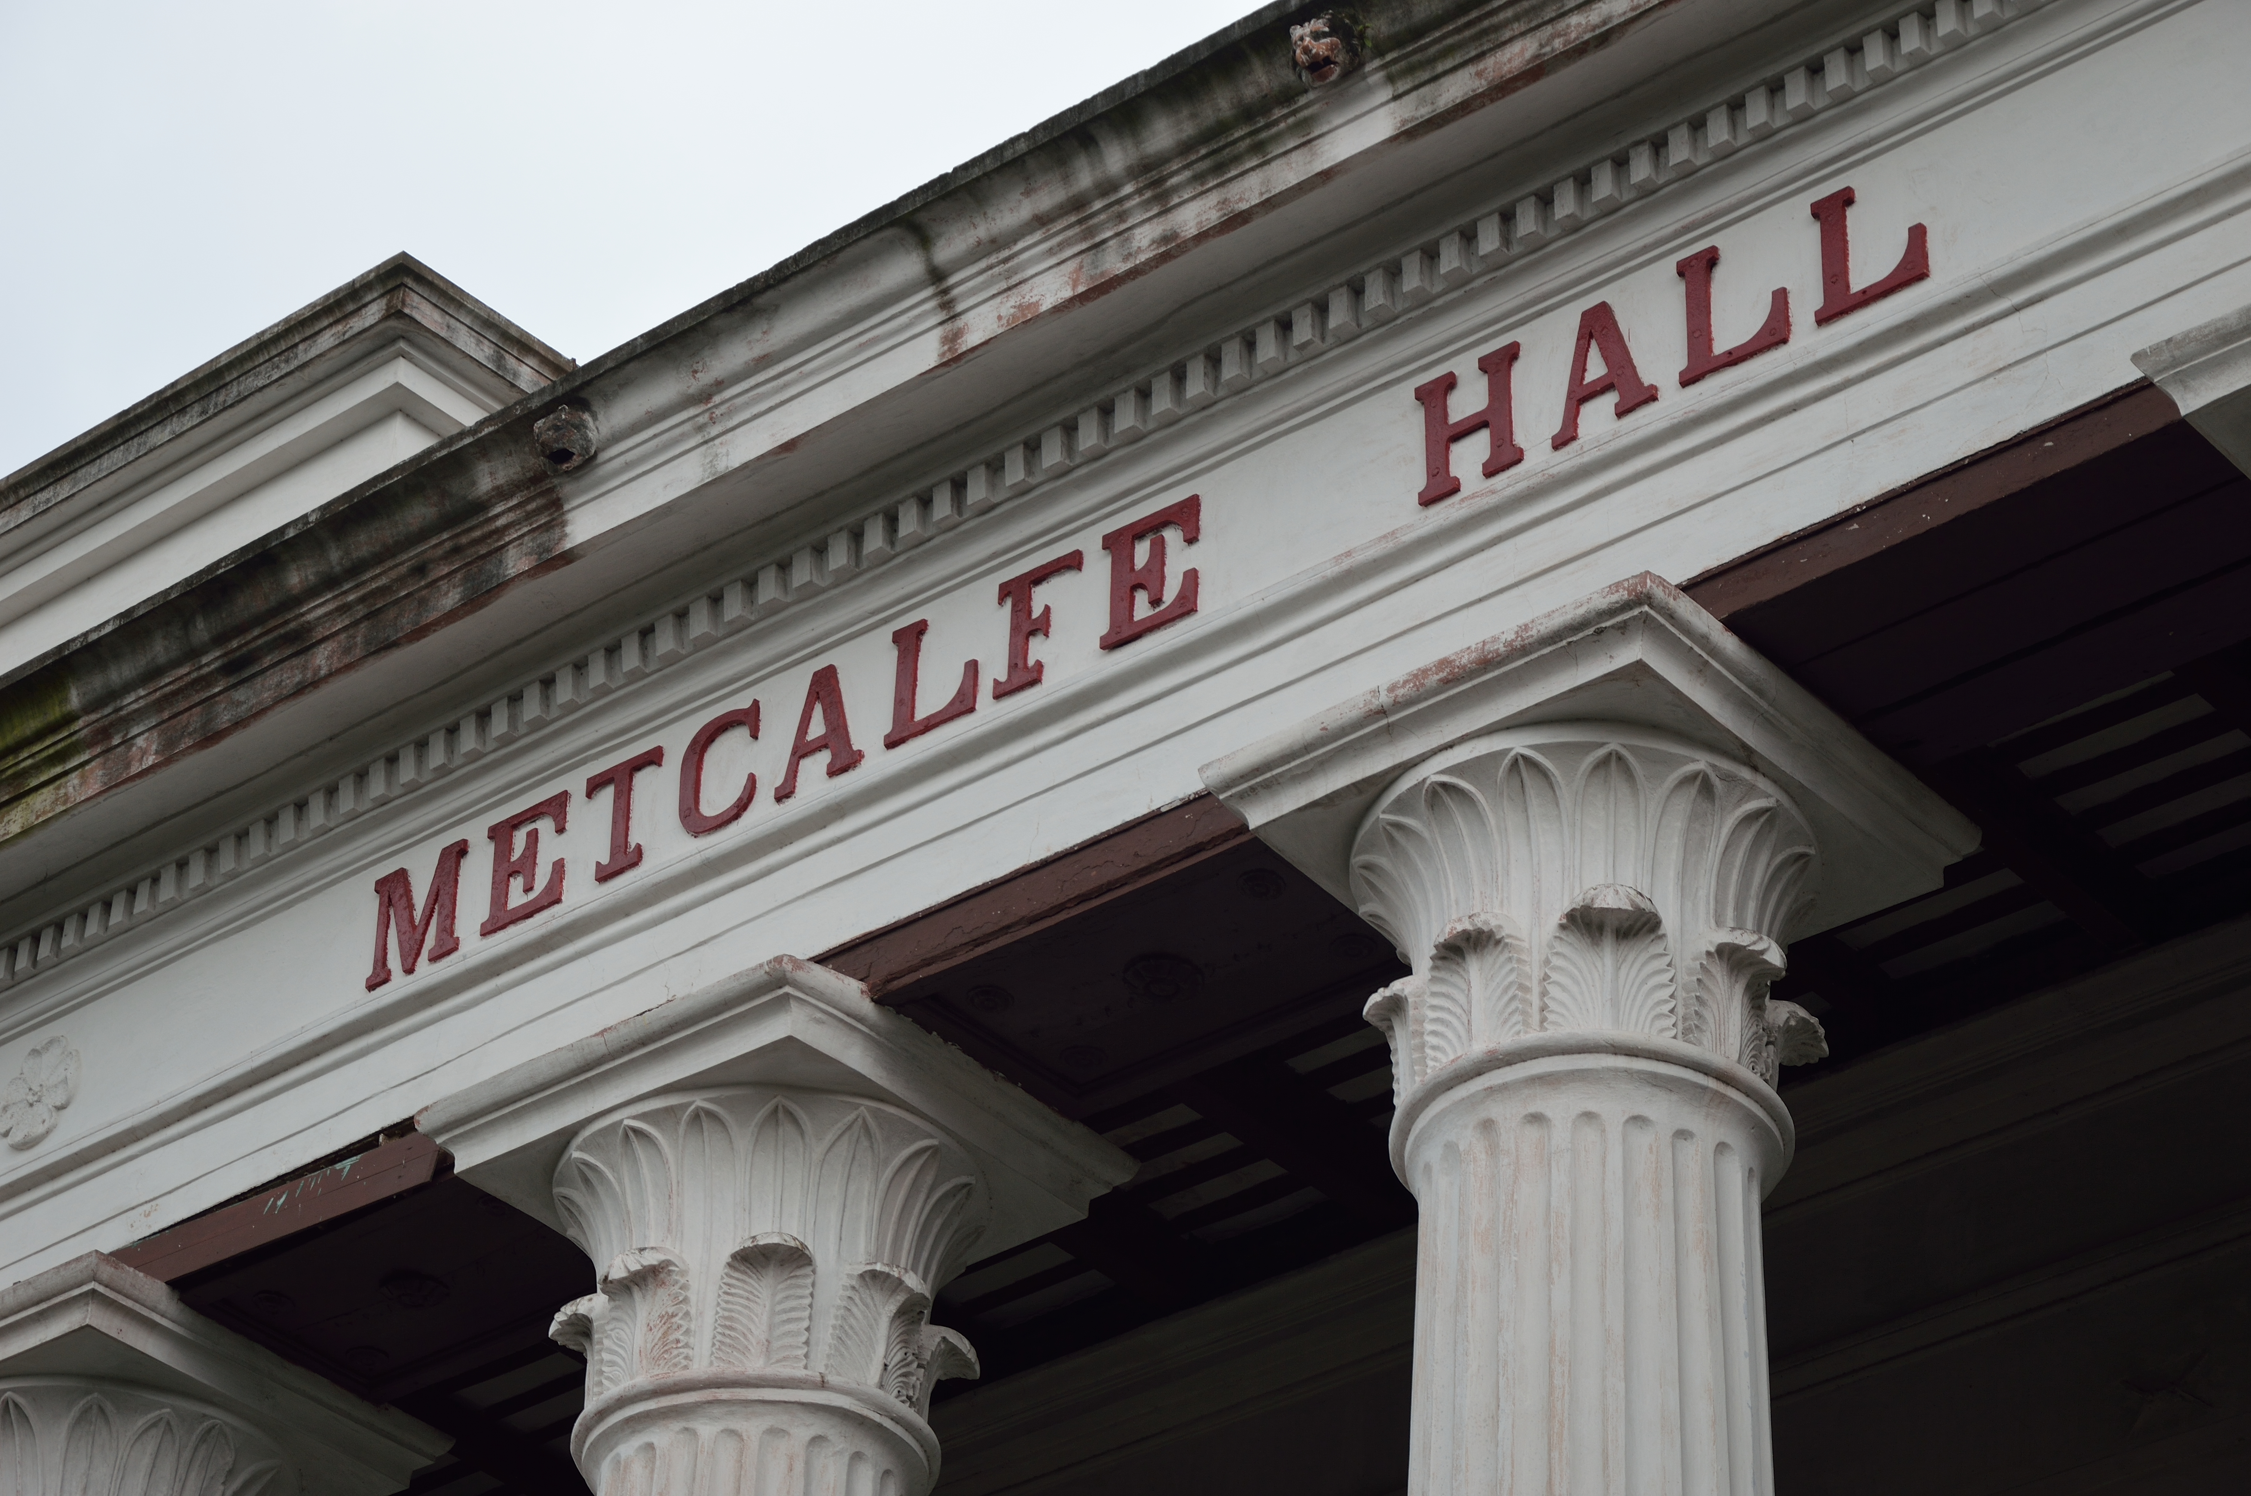
Notes:
WIKI CC - http://commons.wikimedia.org/wiki/File:Metcalfe_Hall_Signage_-_Kolkata_2012-09-22_0327.JPG

Slide 5
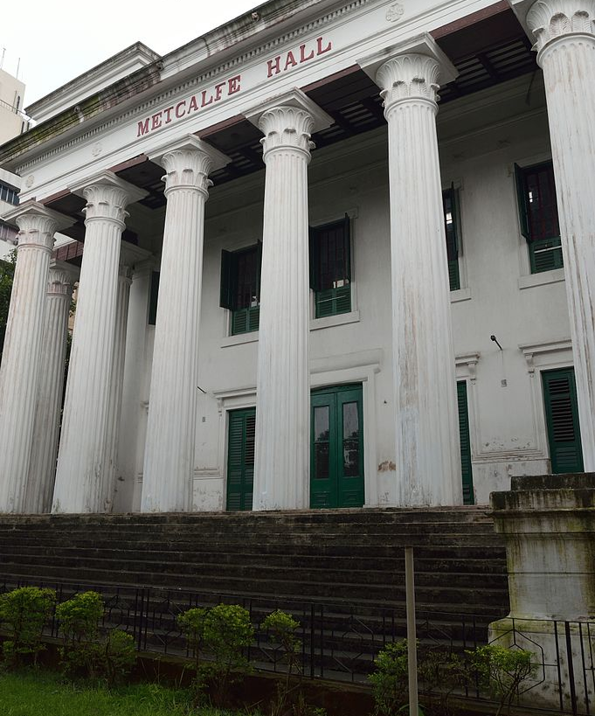
Notes:
WIKI CC - http://commons.wikimedia.org/wiki/File:Metcalfe_Hall_-_Kolkata_2012-09-22_0326.JPG

Slide 6
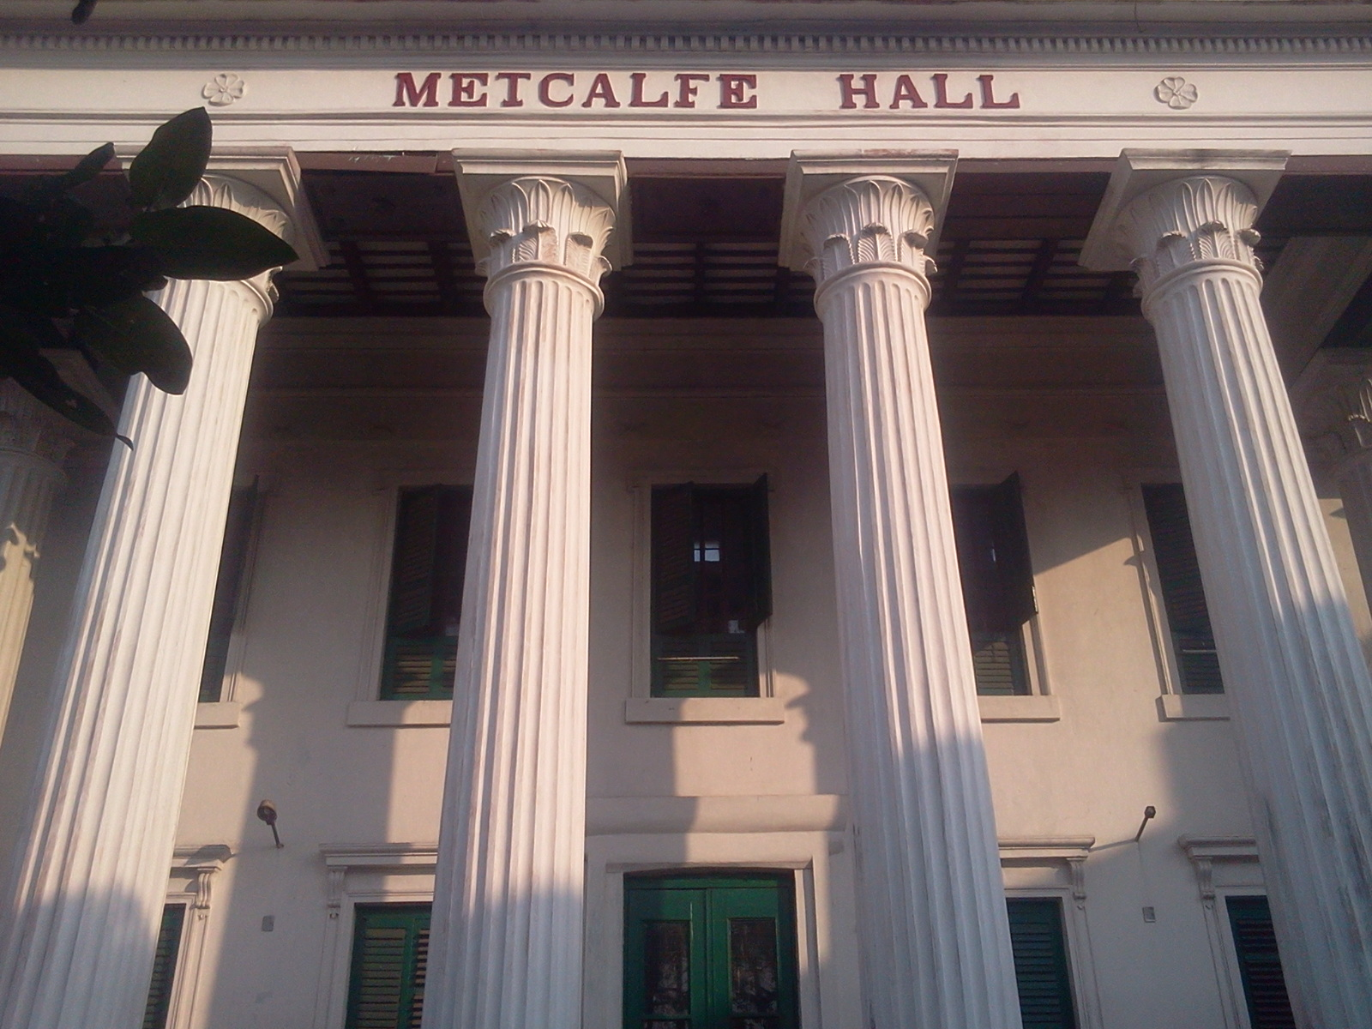
Notes:
WIKI CC - http://commons.wikimedia.org/wiki/File:Metcalfe_Hall,Kolkata.jpg

Slide 7
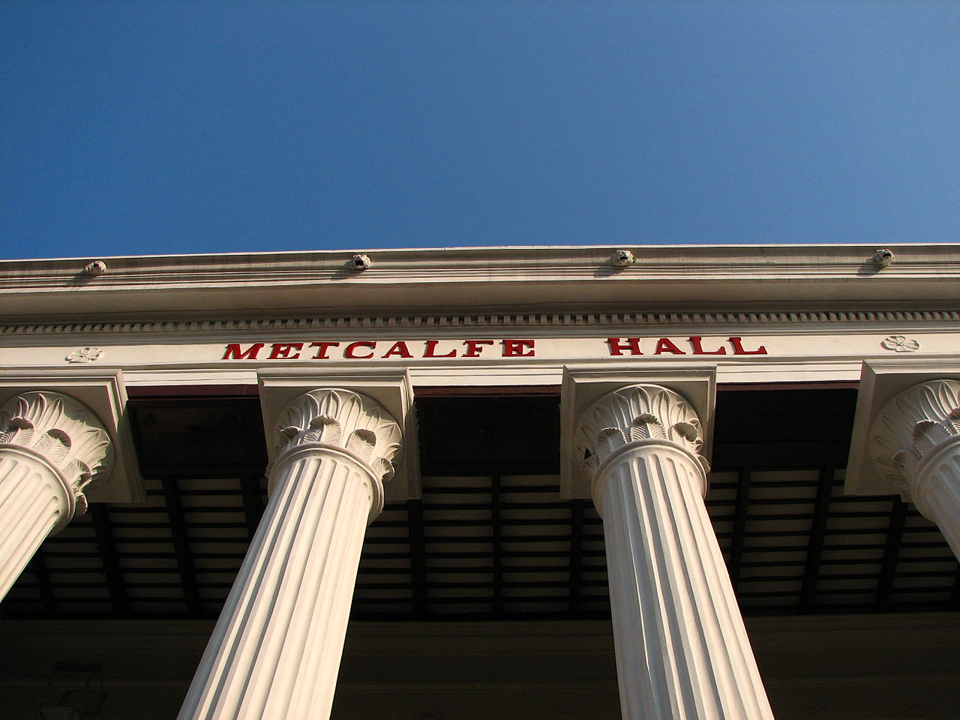
Notes:
WIKI CC - http://commons.wikimedia.org/wiki/File:Metcalfe_Hall_(Detail),_Kolkata.JPG

Slide 8
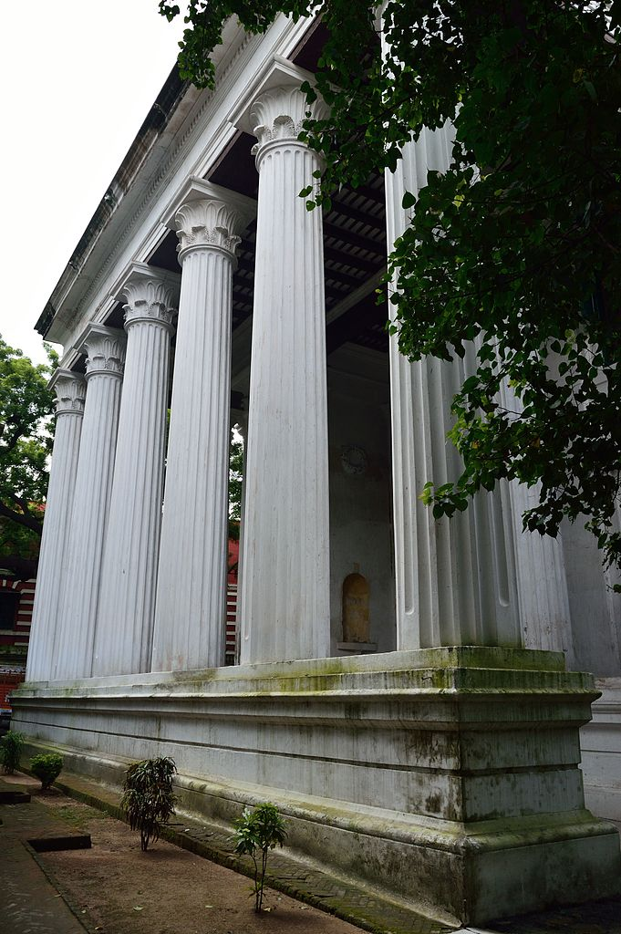
Notes:
WIKI CC - http://commons.wikimedia.org/wiki/File:Metcalfe_Hall_-_Colonnade_-_Kolkata_2012-09-22_0317.JPG

Slide 9
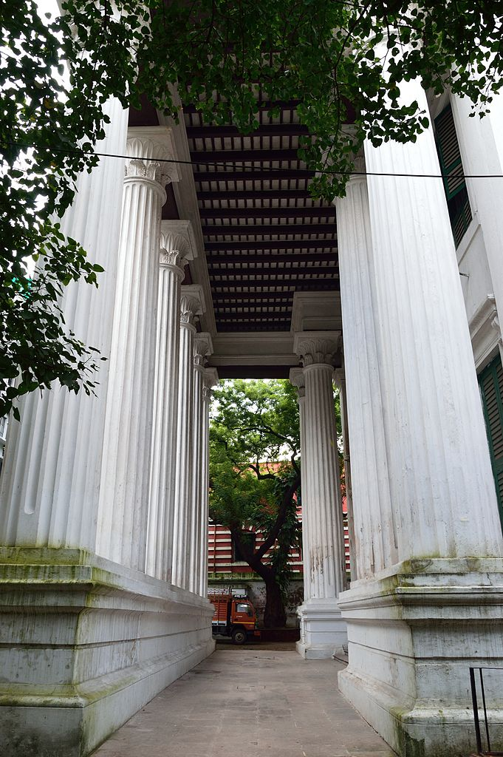
Notes:
WIKI CC - http://commons.wikimedia.org/wiki/File:Metcalfe_Hall_-_Portico_-_Kolkata_2012-09-22_0312.JPG

Slide 10
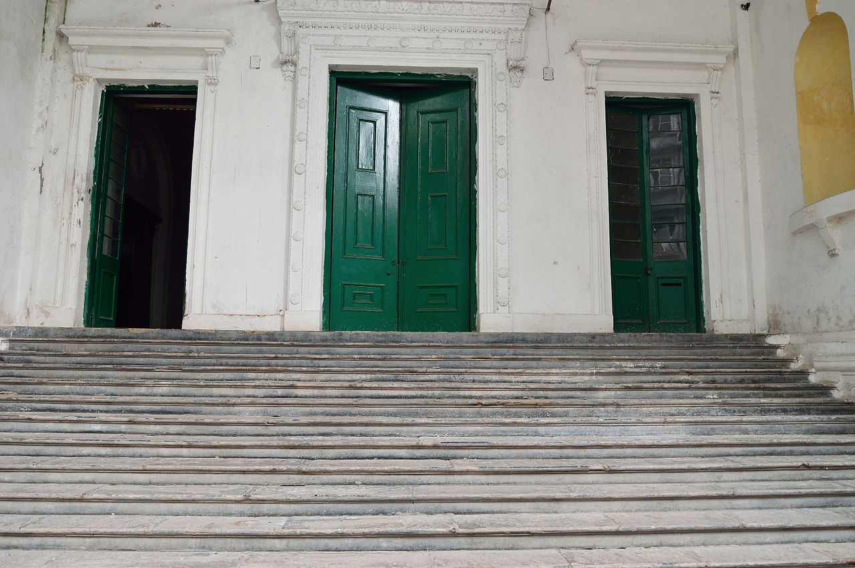
Notes:
WICI CC - http://commons.wikimedia.org/wiki/File:Metcalfe_Hall_-_Stairs_%26_Doors_-_Kolkata_2012-09-22_0314.JPG

Slide 11
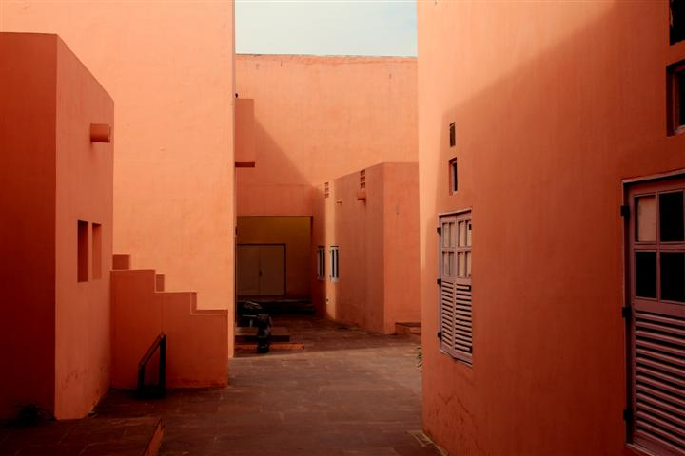
Jawahar Kala Kendra
Jaipur
Notes:
Flickr CC - http://www.flickr.com/photos/dharmesh84/8600150500/sizes/l/

Slide 12
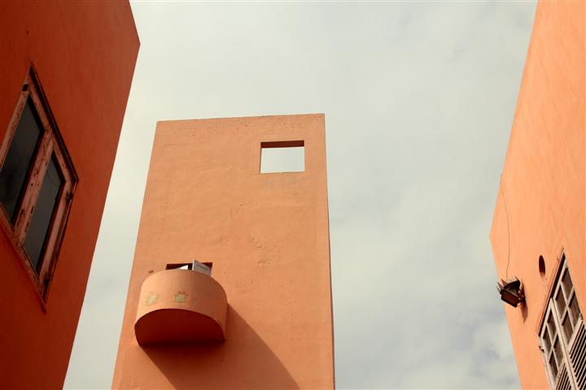
Notes:
Flick CC - http://www.flickr.com/photos/dharmesh84/8600150536/sizes/l/

Slide 13
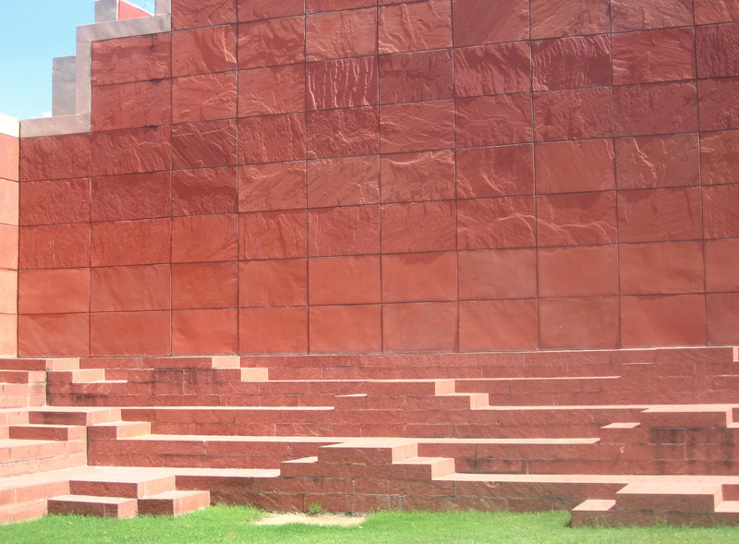
Notes:
Flickr cc - http://www.flickr.com/photos/meanestindian/218884793/sizes/o/

Slide 14
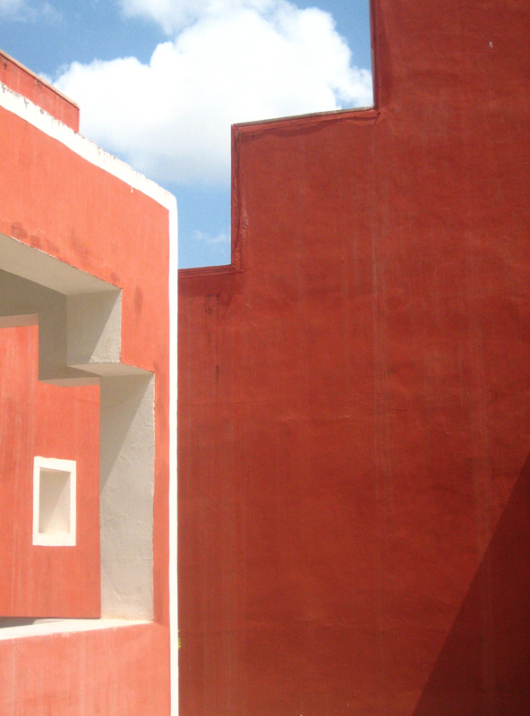
Notes:
Flickr CC - http://www.flickr.com/photos/meanestindian/219634622/sizes/o/

Slide 15
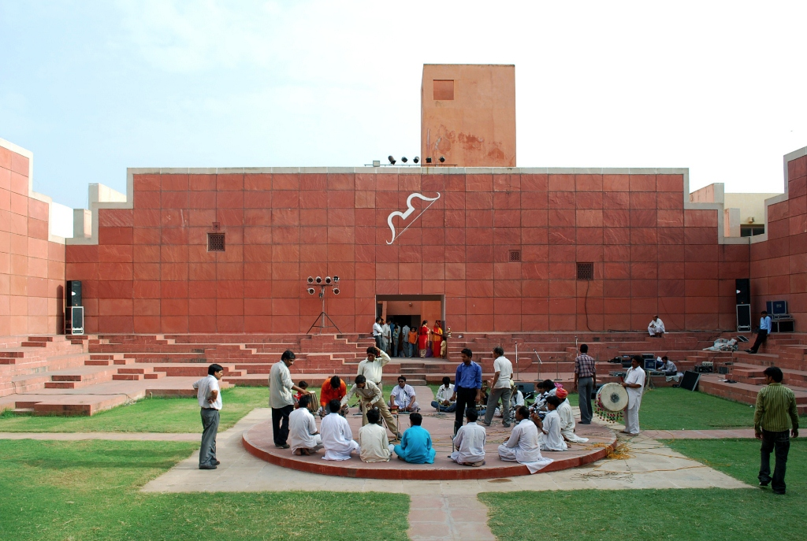
Notes:
WIKI CC - http://en.wikipedia.org/wiki/File:JKK_08.jpg

Slide 16
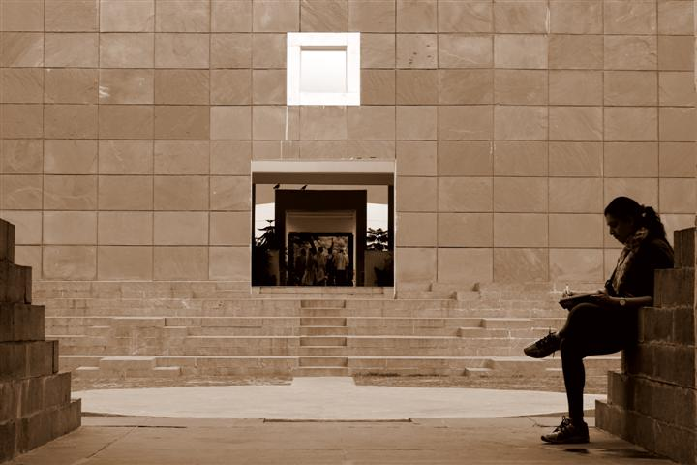
Notes:
Flickr CC - http://www.flickr.com/photos/dharmesh84/8600150580/sizes/o/

Slide 17
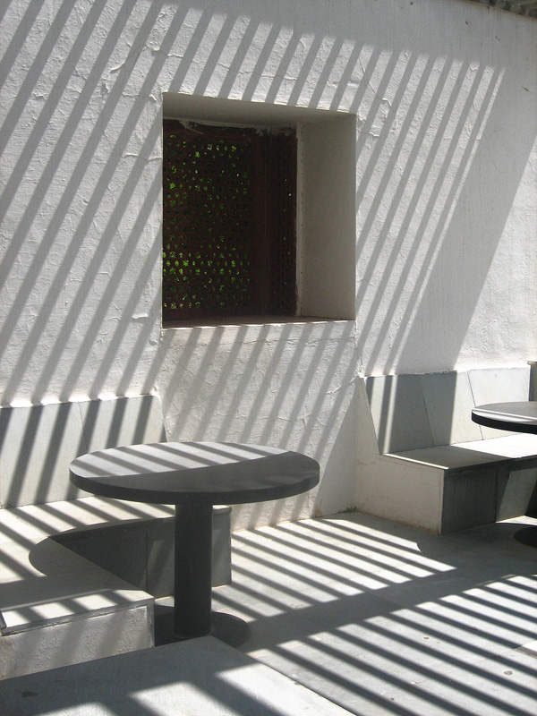
Notes:
Flickr CC - http://www.flickr.com/photos/meanestindian/219634617/sizes/o/

Slide 18
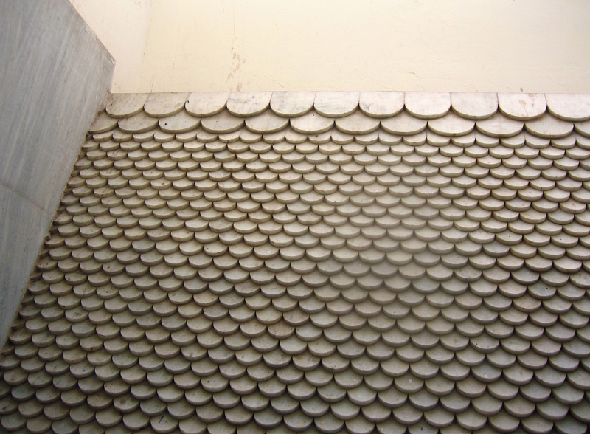
Notes:
Flickr CC - http://www.flickr.com/photos/meanestindian/218884791/sizes/o/

Slide 19
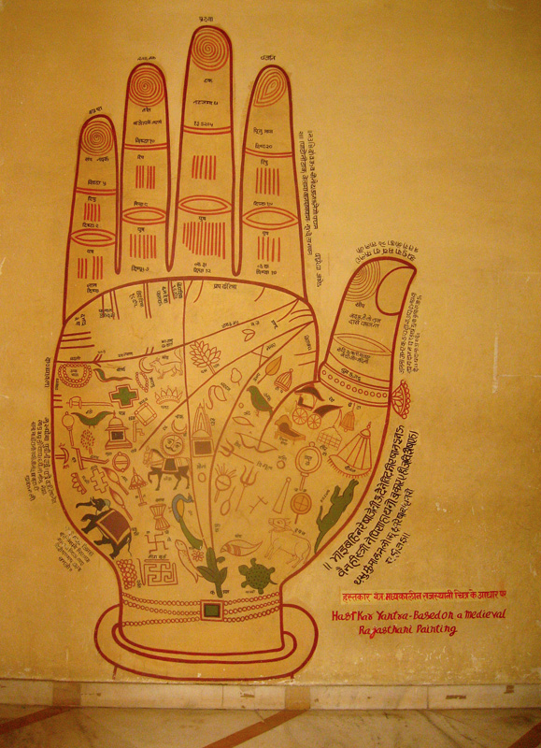
Notes:
Flickr CC - http://www.flickr.com/photos/meanestindian/218884792/sizes/o/

Slide 20
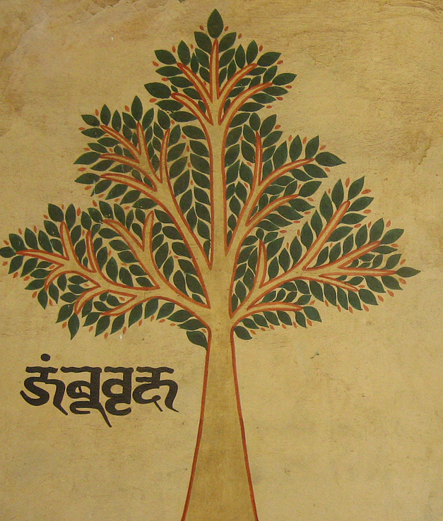
Notes:
Flickr CC - http://www.flickr.com/photos/meanestindian/219634620/sizes/o/

Slide 21
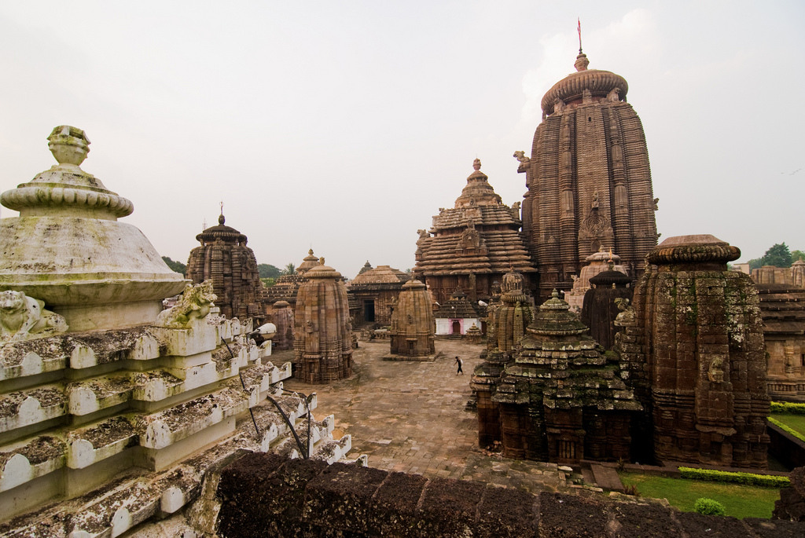
Lingaraja Temple
Bhuvaneshwar
Notes:
Flickr CC - http://www.flickr.com/photos/damienroue/3940086089/sizes/l/

Slide 22
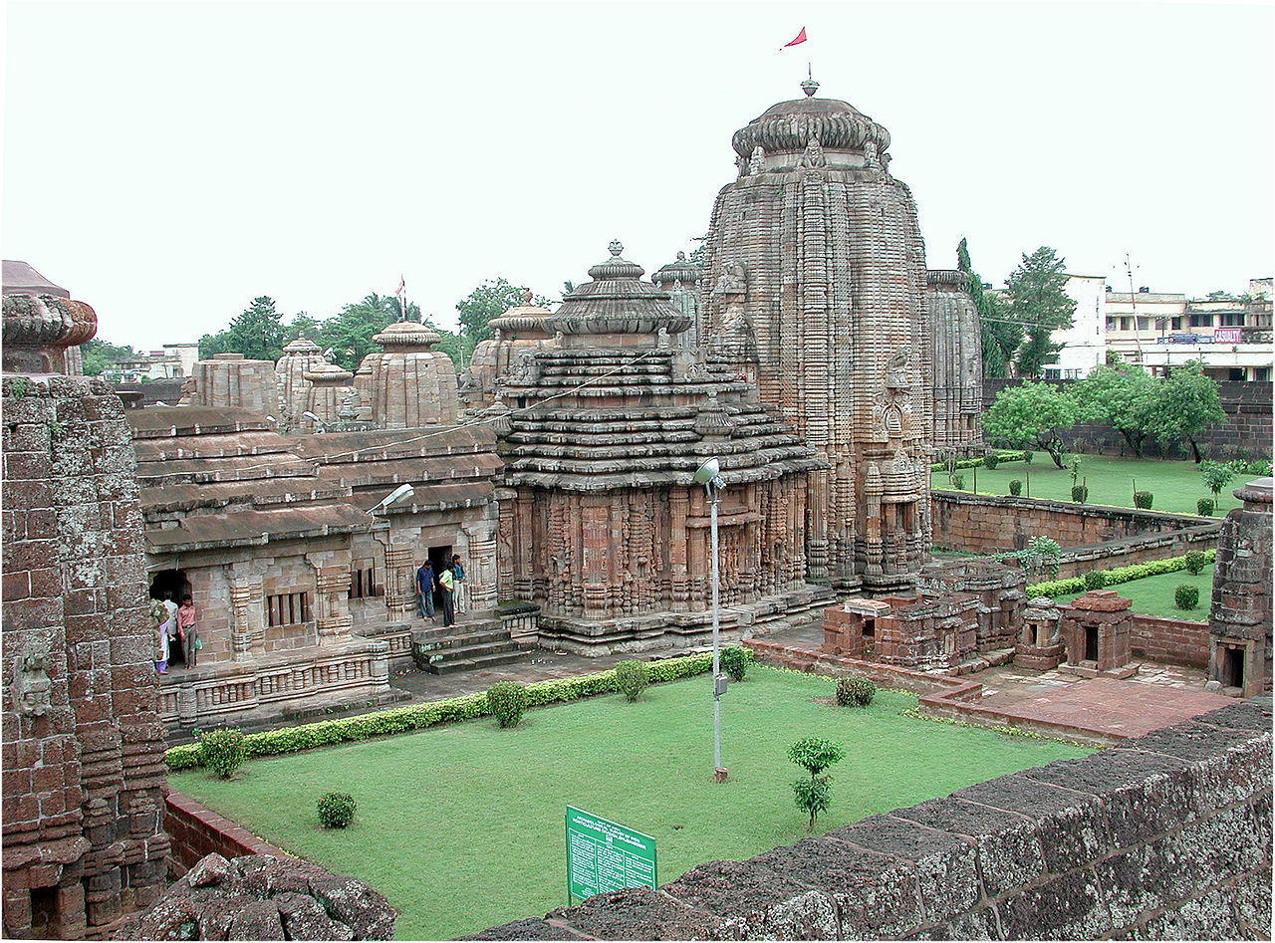
Notes:
Wiki CC - http://en.wikipedia.org/wiki/File:Lingaraj_temple_Bhubaneswar_11007.jpg

Slide 23
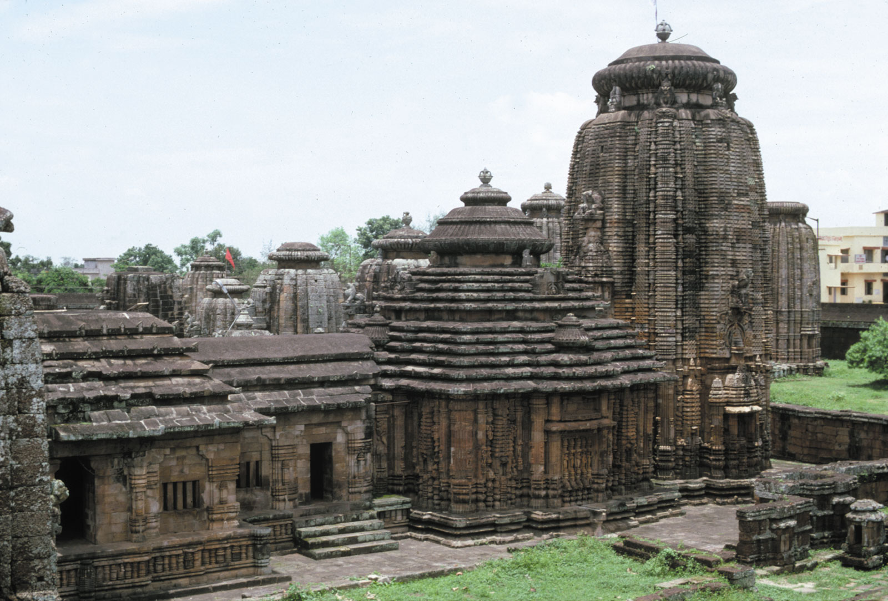
Notes:
Britanicca CC - http://kids.britannica.com/comptons/art-162794

Slide 24
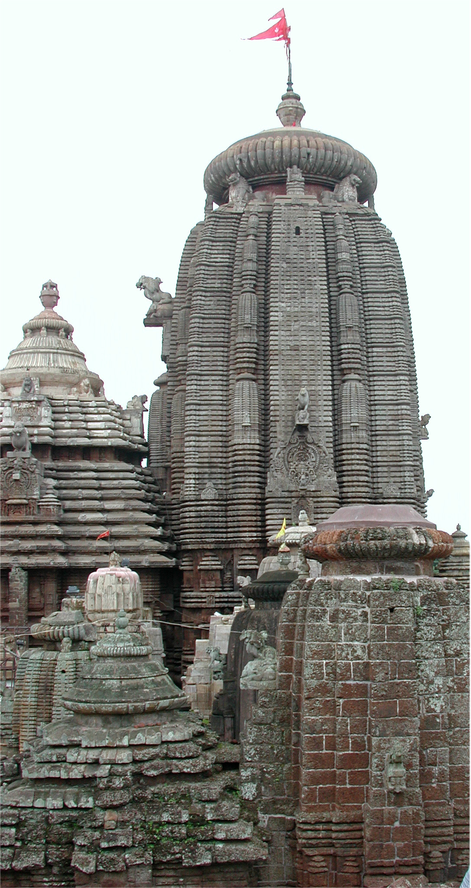
Notes:
Wiki CC - http://commons.wikimedia.org/wiki/File:Lingaraj_temple_Bhubaneswar_11004.jpg

Slide 25
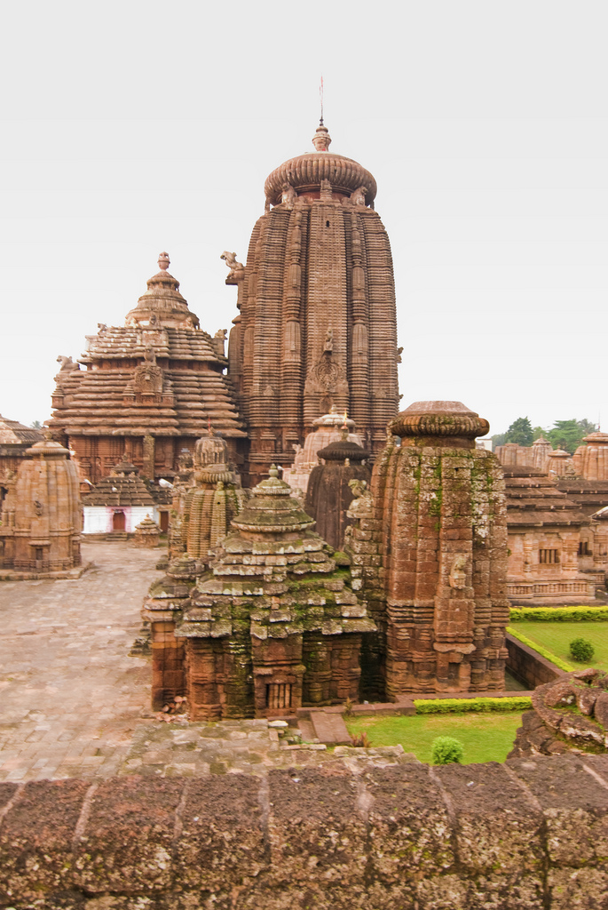
Notes:
Flickr CC - http://www.flickr.com/photos/damienroue/3940086093/sizes/l/

Slide 26
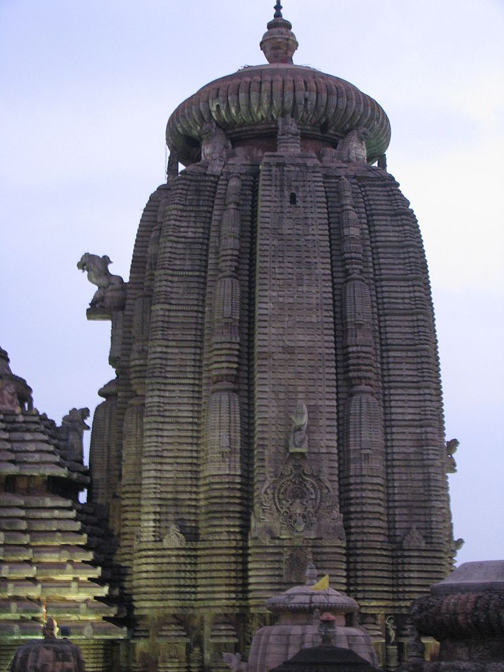
Notes:
Wiki CC - http://commons.wikimedia.org/wiki/File:Lingaraj_Temple_bbsr10.jpg

Slide 27
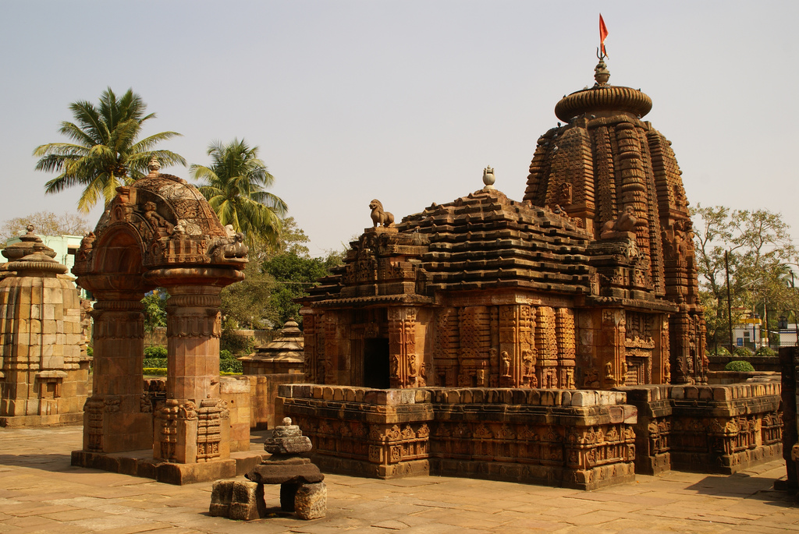
Notes:
Flickr CC - http://www.flickr.com/photos/bupia/2317779643/sizes/l/

Slide 28
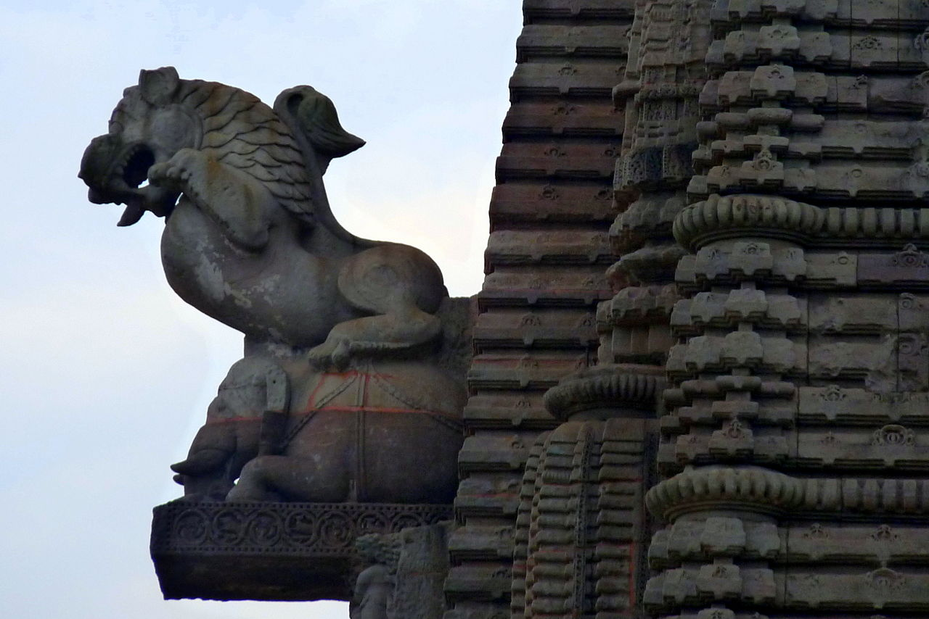
Notes:
Wiki CC - http://commons.wikimedia.org/wiki/File:Lingaraj_Temple,_Bhubaneswar_(3)_-_Oct_2010.jpg

Slide 29
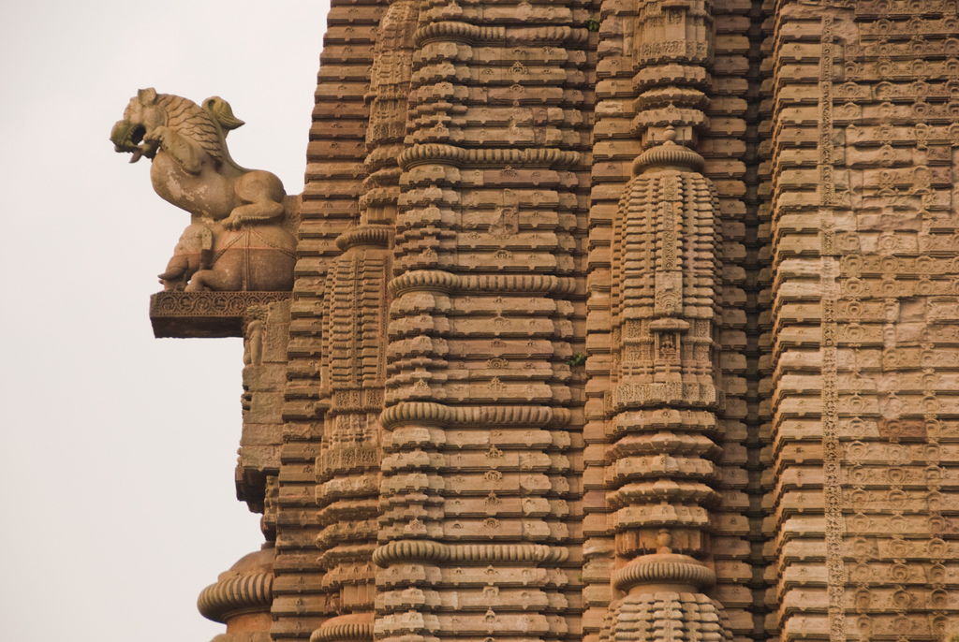
Notes:
Flickr CC - http://www.flickr.com/photos/damienroue/3940086109/sizes/l/

Slide 30
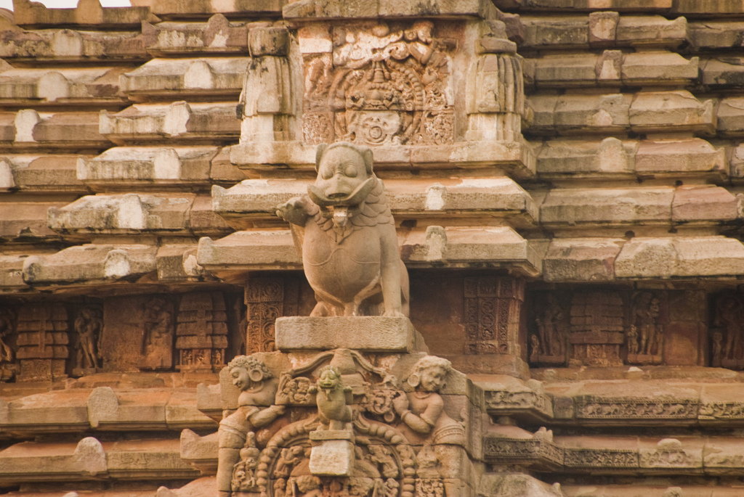
Notes:
Flickr CC - http://www.flickr.com/photos/damienroue/3940086121/sizes/l/

